Slide 1
Copy constructor, Copy assignment operator=, destructor

Slide 2
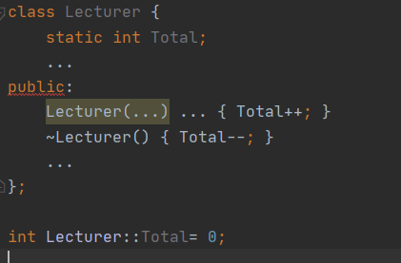
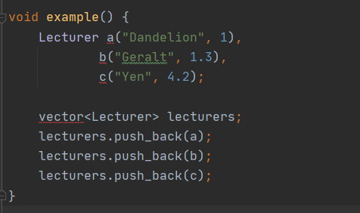
Destructors and copies
Constructor increases a static value, destructor decreases
example(); cout << Lecturer::getTotal();

Slide 3
Explanation
The example prints -3 instead of 0 after all objects out of scope
The problem is copy-construction
Counter not increased on copy
3 locals -> +3
3 copies into list -> 0 increments
Locals "destructed" -> 3-3=0
List copies "destructed" -> 0-3=-3

Slide 4
The rule of three
If a class needs ONE of the following:
Copy Constructor
Copy Assignment operator=
Destructor
Then it probably needs ALL of them
Demo

